Slide 1

Data Analytics in Manufacturing
Presenter Names:
Muskan khan
Pooja B
Pocha Subhashini
Ravindra prajapet

Slide 2
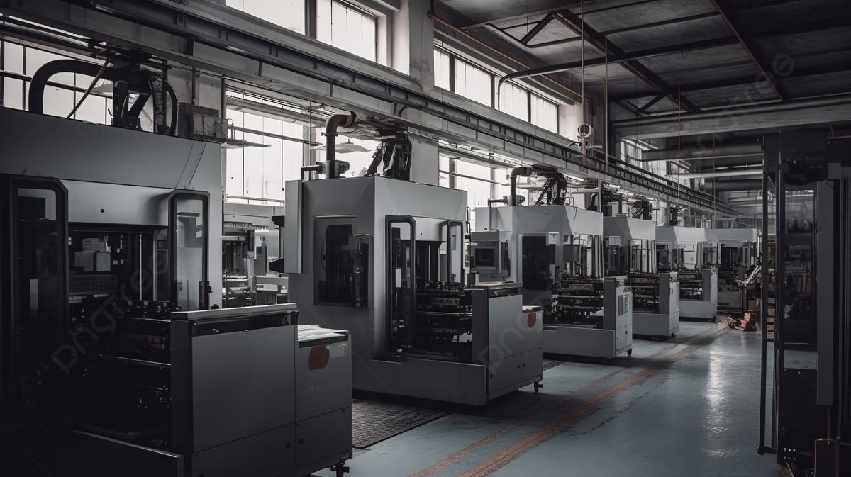
Key Metrics
Manufactured Quantity
Processed Quantity
Rejected Quantity
Wastage Quantity
Employee wise Rejected Quantity
Machine wise Rejected Quantity
Production Comparison Trend
Manufacture vs Rejected Quantity
Department wise Manufacture vs Rejected Quantity
Operation wise Rejected Quantity
Operation wise Processed Quantity
Top 10 Employees

Slide 3
SUMMARY:
Manufacturing is the process of transforming raw materials into finished products through various techniques, including machining, assembly, and fabrication. It plays a crucial role in the economy by driving innovation, creating jobs, and contributing to GDP. Modern manufacturing increasingly leverages advanced technologies like automation, robotics, and data analytics to enhance efficiency and reduce costs. Key performance
indicators (KPIs) are essential for measuring success,
with tools such as Excel, Power BI, Tableau, and SQL
Enabling businesses to analyze data, track performance,
and make informed decisions. As the industry evolves,
challenges such as labor shortages and sustainability
concerns necessitate adaptive strategies,
highlighting the importance of a data-driven
approach for future competitiveness.

Slide 4
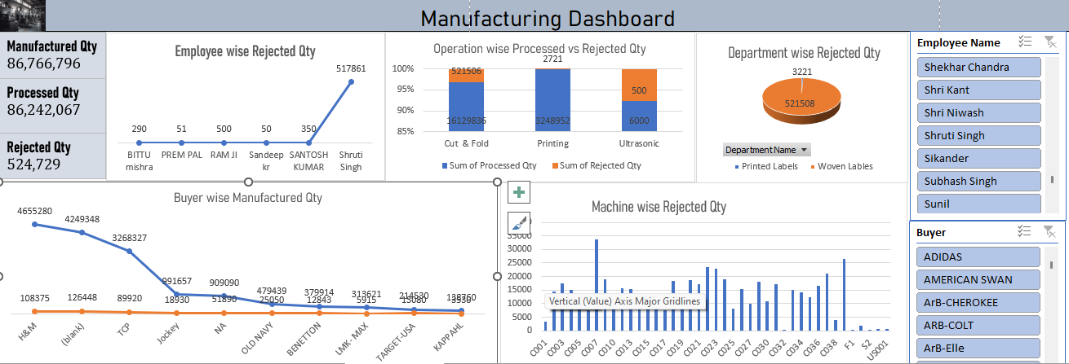
Implementation of KPI’s using Excel:

Slide 5
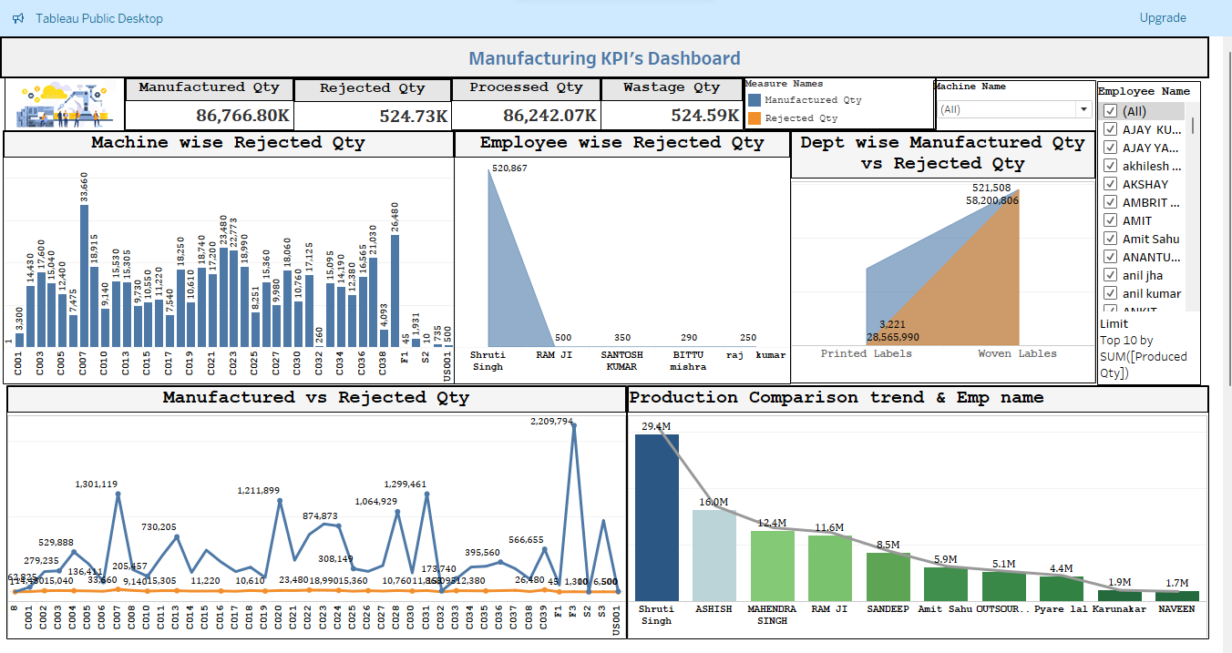
Implementation of KPI’s using Tableau:

Slide 6
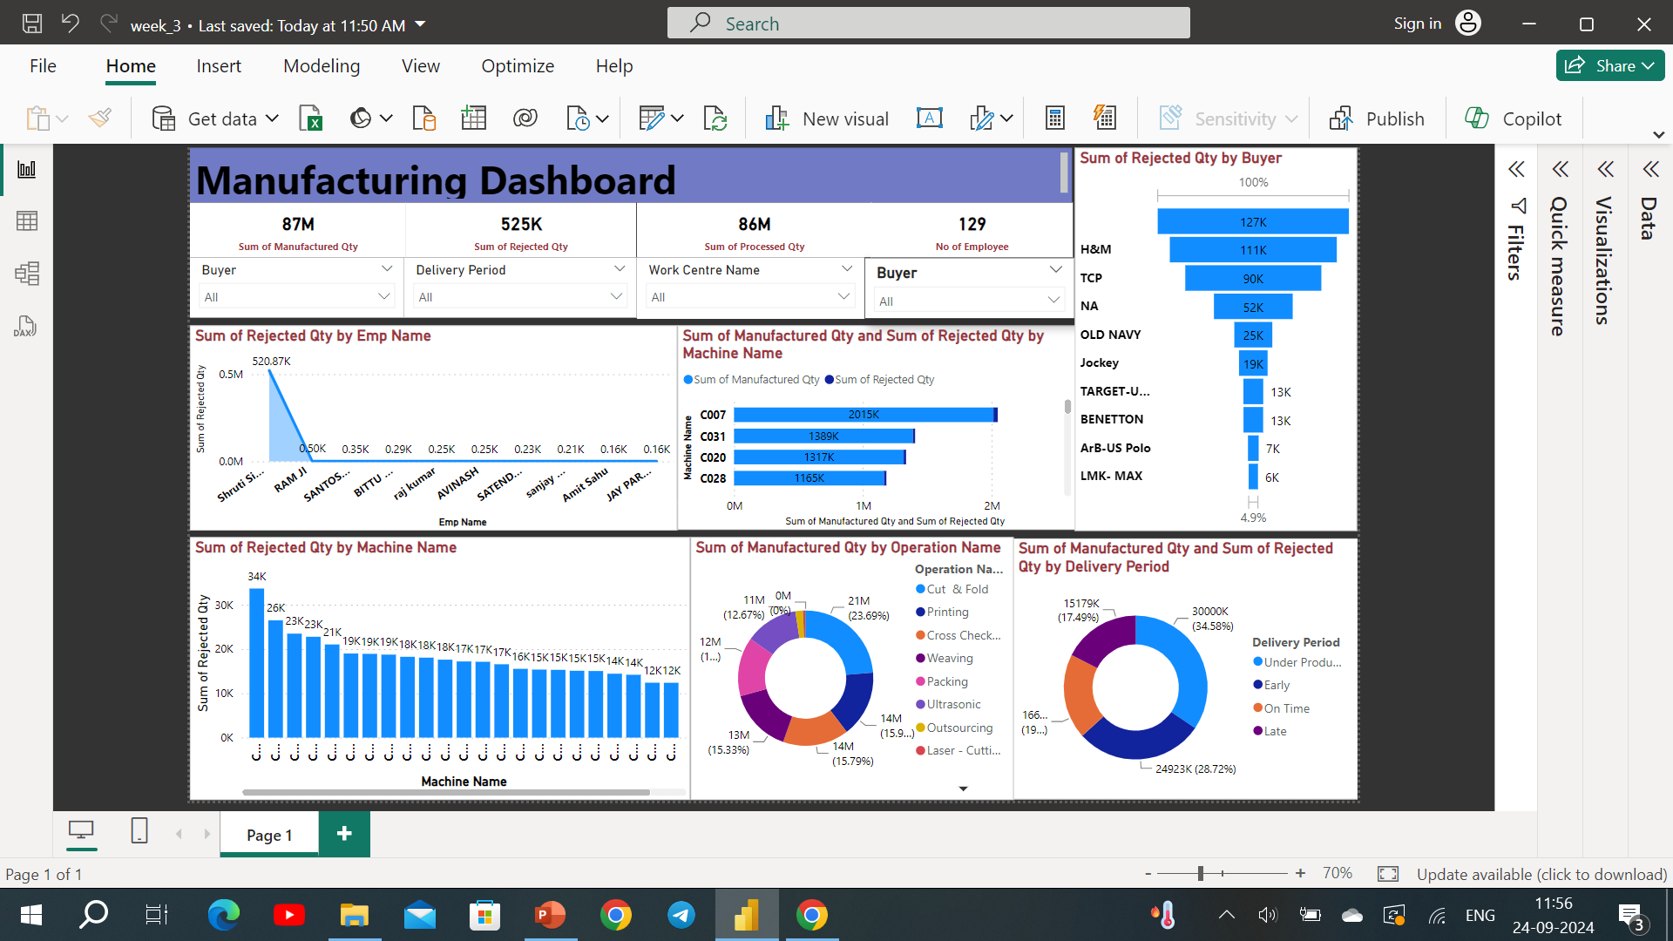
Implementation of KPI’s using Power Bi with SQL:

Slide 7
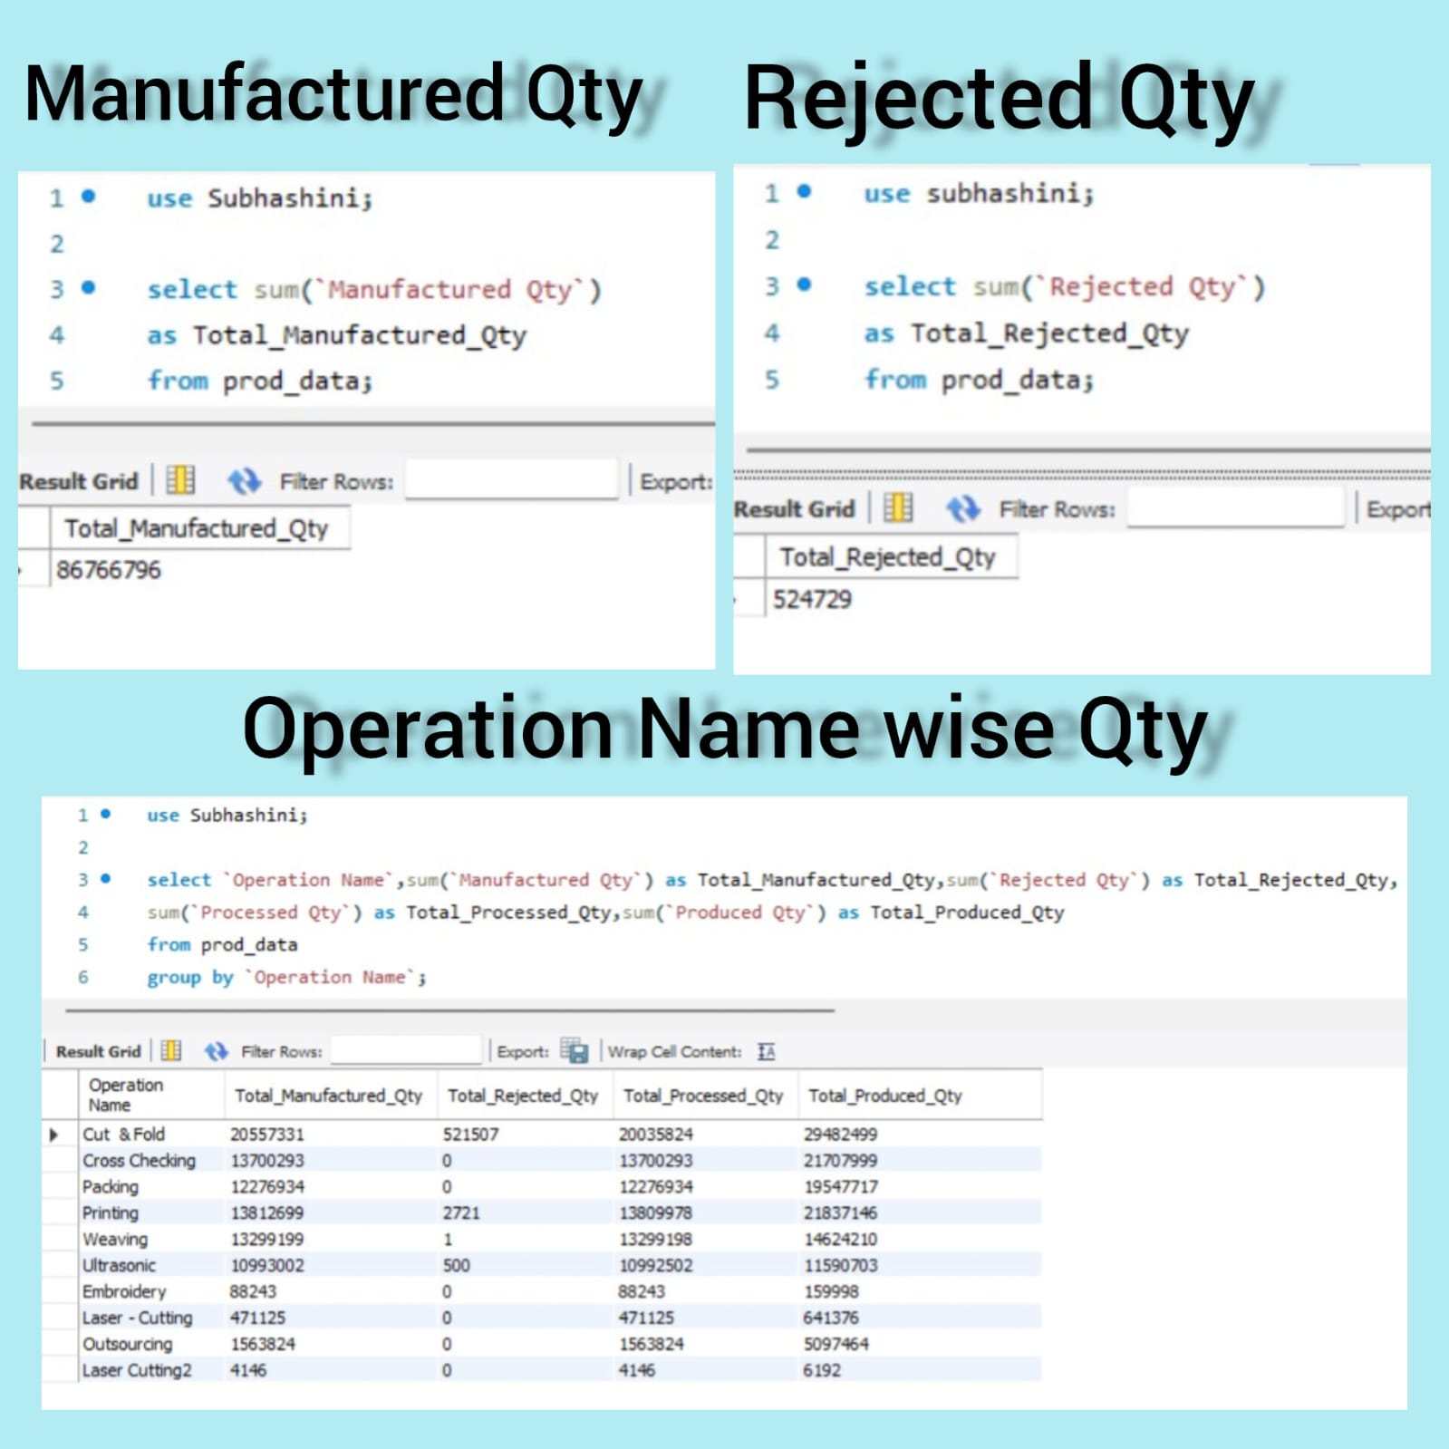
SQL Queries for KPI’s:

Slide 8
Insights from Analysis:
There is highest rejection quantity under the Employee ‘Shruthi Singh’. Though the manufactured qty is also higher, we need to look into the reasons for the rejection rate.
The top 10 machines where the rejection rate is maximum are C007,C0039,C022,C023, C037,C024,C008,C020,C018,C028. The reasons for the wastage/rejections produced by these machines should be looked through.
Woven Department, Cut and fold sector is having highest rejection so more attention should be given here to reduce rejected quantity.

Slide 9
Key Takeaways:
ONE: Customer feedback, complaints, and reviews to identify areas for improvement for reducing the Rejected Quantity.
TWO: We can see from the reports that few machines produce the highest number of rejected quantity so analyzing the machine errors with sensor data and historical records to predict when equipment will need maintenance or fail to reduce the errors.
THREE:
Understanding the product, machine performance and customer preferences can help optimize inventory and reduce returns.

Slide 10
THANK YOU!

